Slide 1
(un)travel
Supporting Local Business
POV & EXPERIENCE PROTOTYPES
Natasha Goh, Ben Gregory, Michelle Huang, Cooper Reed

Slide 2
PROBLEM DOMAIN
SERENDIPITY AND COMMUNITY
SUPPORTING LOCAL BUSINESS

Slide 3

INITIAL POV
We met… Phillip, an early 30s professional who loves exploring new neighborhoods and discovering new bars and restaurants in LA
We were amazed to realize… since COVID, he now only visits businesses where he has an established relationship with the owners because he knows they are taking the necessary safety precautions.
It would be game-changing to… create discovery tools to give people confidence that they can explore new places safely.
Notes:
Reads LA Times and LA Weekly
Spends his free time biking to other neighborhoods trying out new food trucks and pop ups

Slide 4
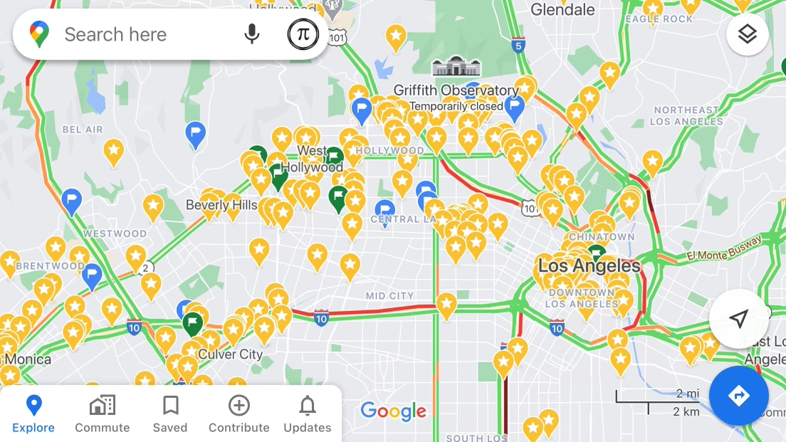
INITIAL POV
We met… Phillip, an early 30s professional who loves exploring new neighborhoods and discovering new bars and restaurants in LA
We were amazed to realize… since COVID, he now only visits businesses where he has an established relationship with the owners because he knows they are taking the necessary safety precautions.
It would be game-changing to… create discovery tools to give people confidence that they can explore new places safely.
Notes:
He makes notes of recommendations from colleagues / friends and girlfriend keeps detailed maps of pinned locations

Slide 5
Additional Needfinding Results

Slide 6
Local
Online

Slide 7
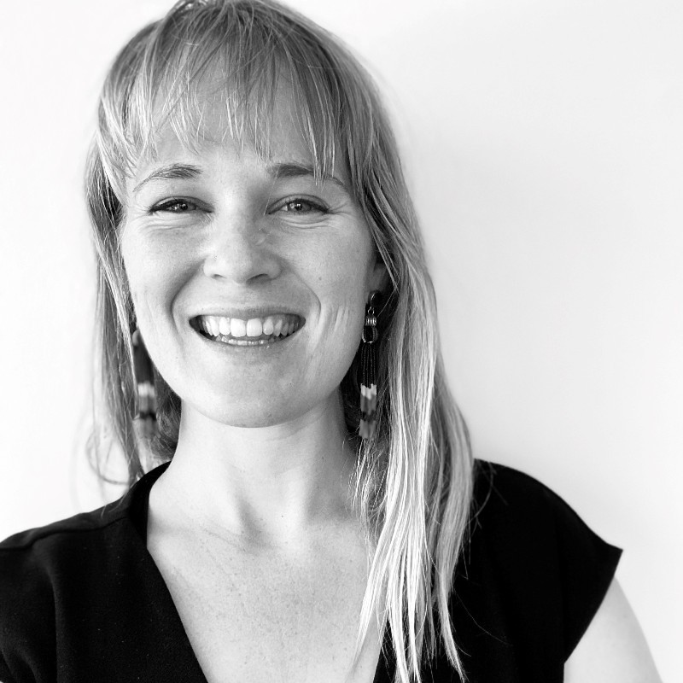
“I get overwhelmed shopping online - it’s almost too much information. I was looking for a humidifier and then spent like an hour looking at different reviews.”
Sarah
Northwestern Grad Student,
Food Sustainability Consultant
Notes:
Insight: Paradox of choice with internet options
Insight: Prefers local primarily for sustainability reasons
Insight: "Going from 'Hello' to 'Nice to see you'...that slight difference can feel really nice."
Tension: Not all internet shops are created equal; Etsy feels more local than Amazon
Tension: Wants to shop local and support minority and women owned businesses but doesn’t know where to find them locally

Slide 8
“If I’m in a new, unfamiliar place, I default to prominent and reputable stores like Walmart or shop on Amazon.”
Nathaniel
Stanford student,
Tech enthusiast
Notes:
Insight: Prefers to shop online because he believes it has the best prices
Insight: When traveling, he’ll rely on large brands.
Tension: Although he believes large chains have the best prices, he doesn’t price shop

Slide 9
Revised POVs

Slide 10
POV #1 - Intentional
We met… Sarah, a young adult who prefers shopping in-person, primarily due to sustainability concerns around shipping.
We were amazed to realize… she has difficulty shopping in-person AND supporting minority-owned brands because it’s hard to find nearby minority businesses, causing anxiety as she has to choose between the two.
It would be game-changing to… provide her with access to more shopping options that give her the confidence that all of her values are being met.
Notes:
10 HMWs:
how might we make local minority-owned brands more visible
how might we make in-person shopping more viable during covid
how might we reduce the footprint of shipping boxes/packaging
how might we combine the pros of online and offline shopping
How might we more accurately map a business's values and impact?
How might we increase brand education for business owners?
how might we make people more aware of local businesses
How might we measure a business's covid-readiness relative to others?
How might we increase people's awareness of their community's geography?
how might we make in person shopping more convenient

Slide 11
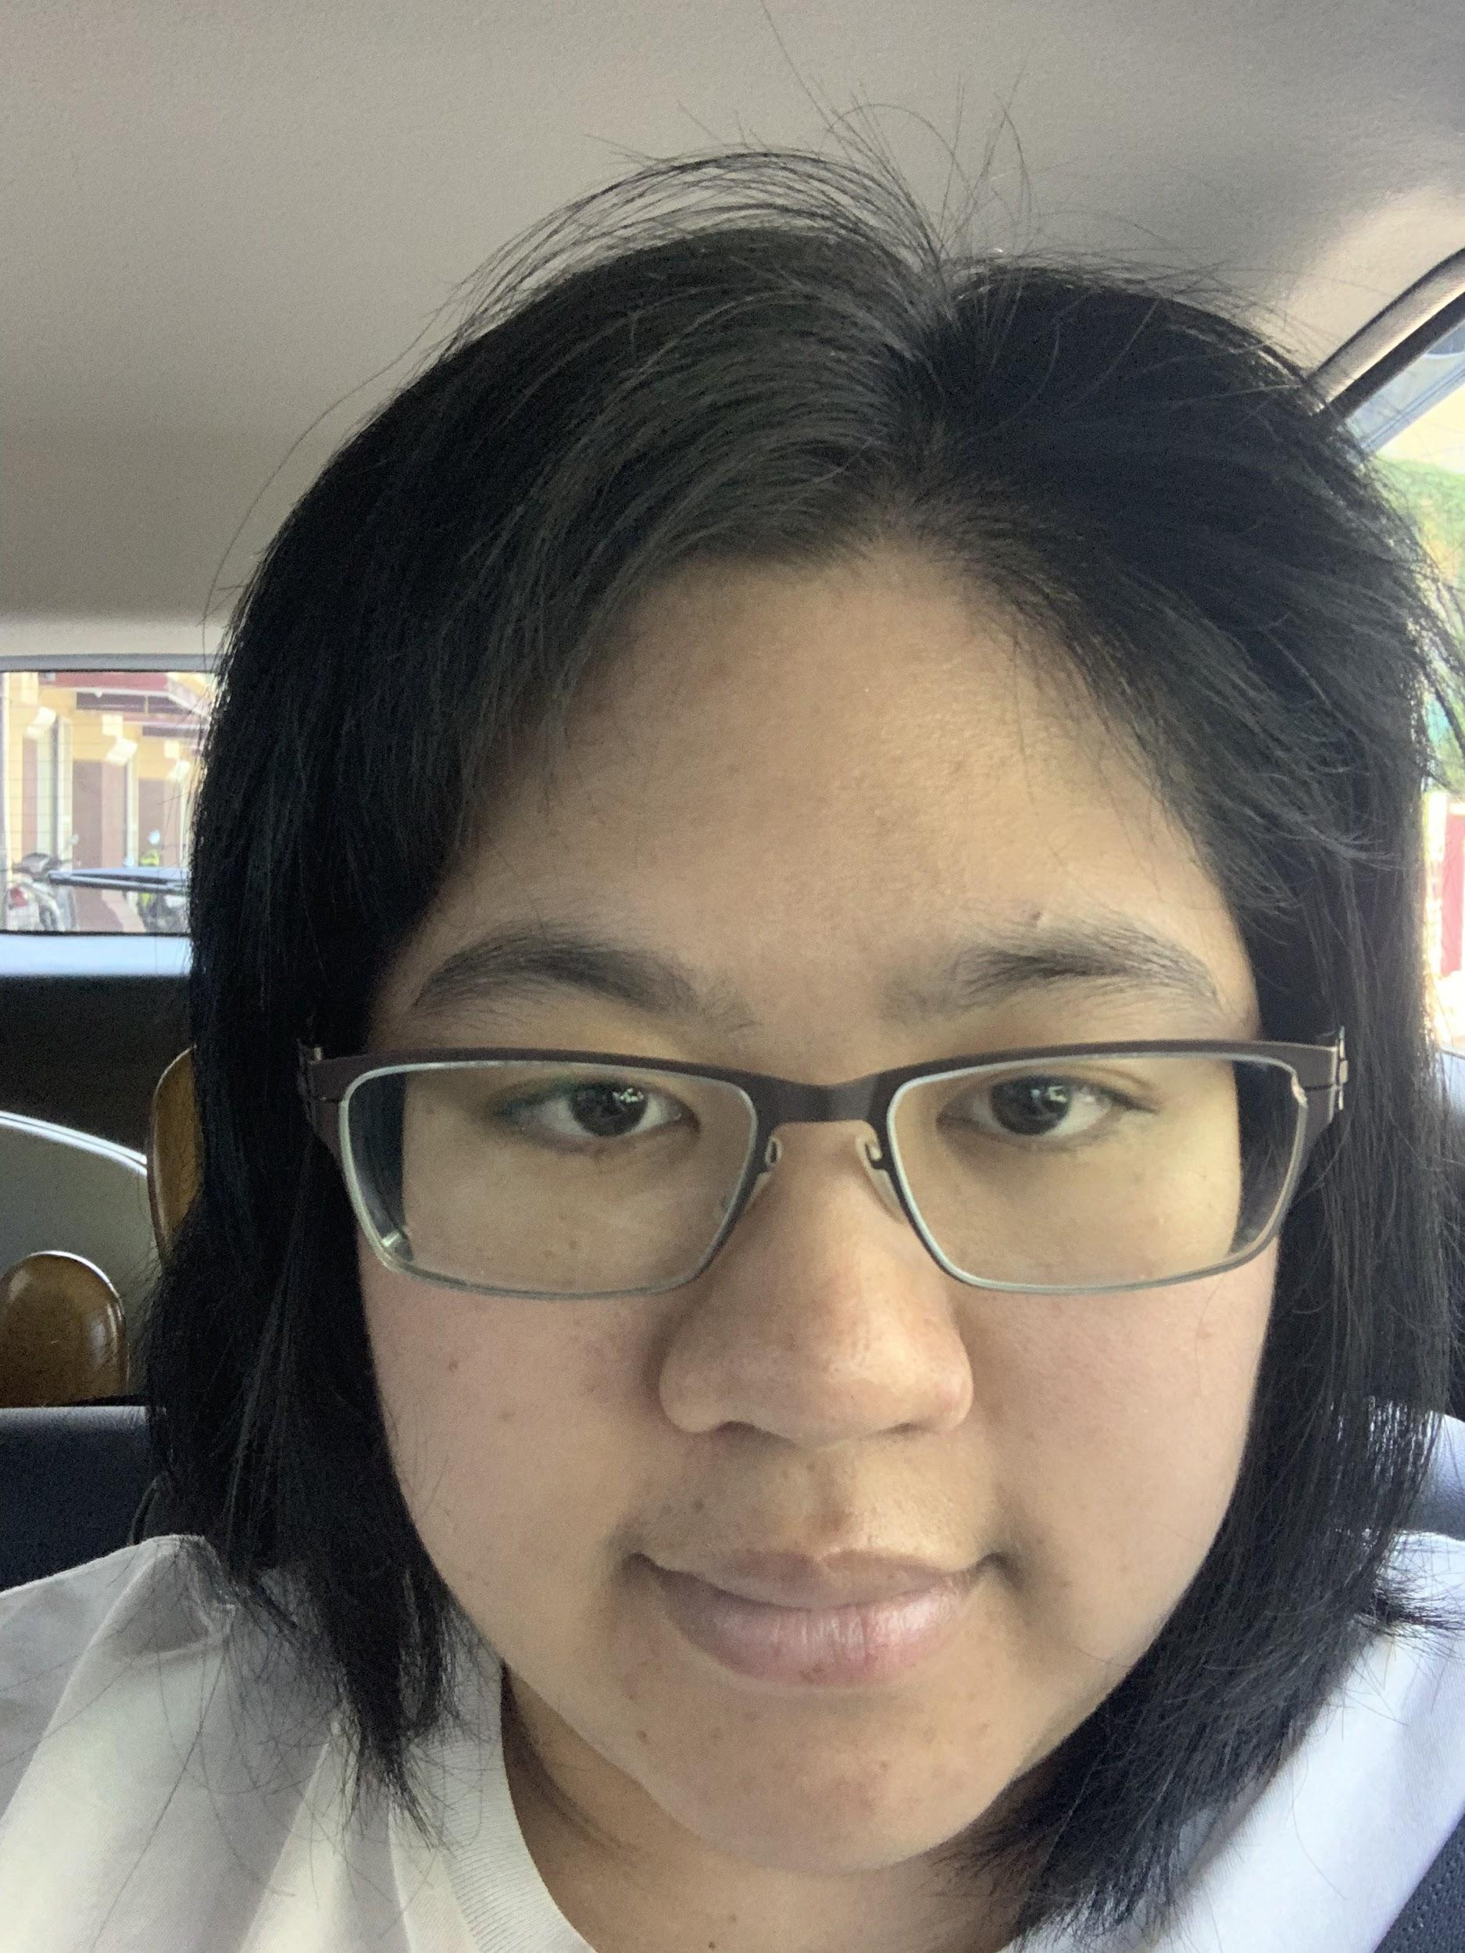
POV #2 - Adventurous
We met… Aniya, a Thai foodie who has been on the search for new restaurants since COVID caused some of her favorite places to shut down.
We were amazed to realize… some restaurants only advertise in a certain language and remain unknown to potential customers who don’t search in that language.
It would be game-changing to… help people overcome the language barrier and discover more authentic small restaurants.
Notes:
10 HMWs:
how might we make people more aware of cuisine characteristics
how might we communicate without needing language?
how might we completely remove the language obstacle?
how might we reduce the cost of translating advertisements
how might we establish trust without full verbal understanding?
how might we integrate ethnic businesses into language learning?
How might we increase foot traffic // customers for non-english (/dominant lang) speaking businesses?
How might we automate translation to prevent this work from falling to owners OR customers?
How might we increase a user's likelihood to investigate names they're unable to read?
how might we help ethnic business owners see they have a larger potential market?

Slide 12
POV #3 - Value
We met… Nathaniel, a college student who prioritizes having a larger selection and maximizing value when shopping.
We were amazed to realize… he defaults to staple retail brands (i.e. Walmart, Amazon) due to perception of consistent convenience and value.
It would be game-changing to… have better information around the availability and prices of items at more stores to get better options.
Notes:
10 HMW:
How might we create the sense of "familiarity" which draws consumers to chain businesses?
how might we create a symbiotic relationship between small businesses and big box retailers
how might we distinguish in-person shopping from online in domains other than price
how might we streamline the review-reading process for higher value items
how might we dispel the notion that large retail chains always offer better value?
how might we help people distinguish credible reviews from non credible ones
How might we demonstrate to consumers the value of shopping at smaller businesses?
how might we help people reliably find good local shops
how might we make it cheaper for small businesses to have their prices and inventory easily accessible?
How might we increase the draw of tiny businesses?

Slide 13
Top 3 HMWs, Solutions, and
Experience Prototypes

Slide 14
HMW #1
We met… Sarah, a young adult who prefers shopping in-person, primarily due to sustainability concerns around shipping.
We were amazed to realize… she has difficulty shopping in-person AND supporting minority-owned brands, causing anxiety as she has to choose between the two.
It would be game-changing to… provide her with access to more shopping options that give her the confidence that all of her values are being met.
How might we...
more accurately map and make available a business's values and impact?
Our solution pick:
Platform for businesses to communicate their story and values to consumers

Slide 15
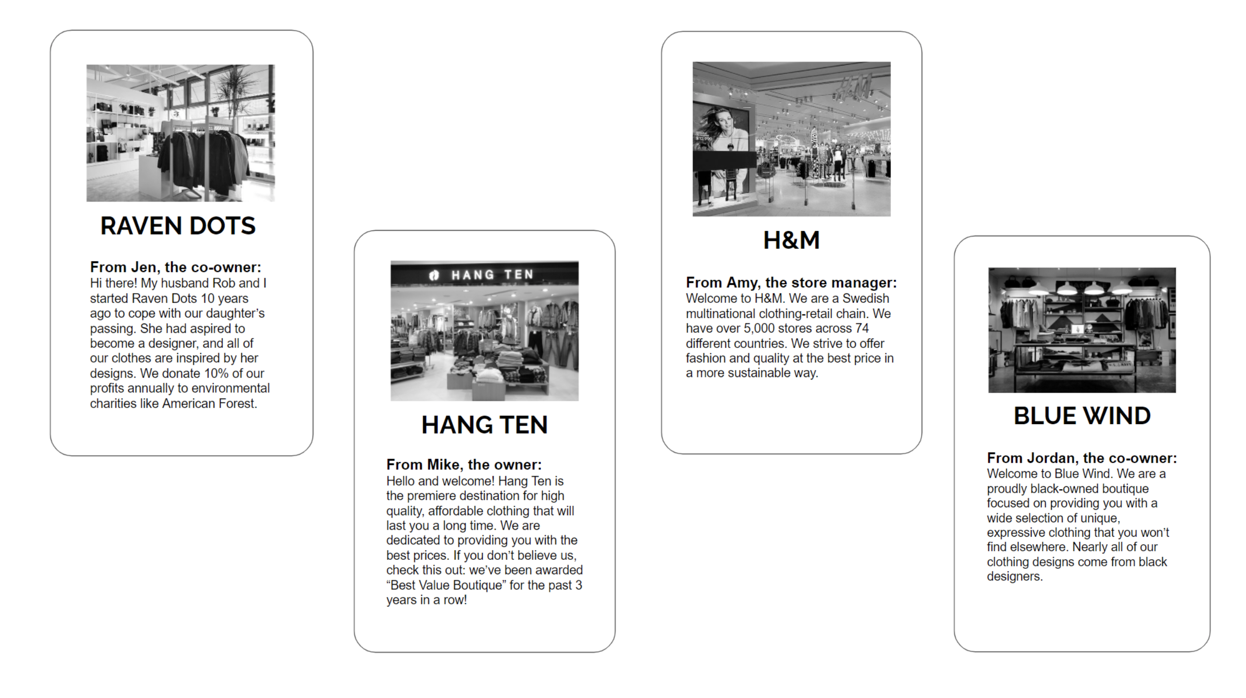
PROTOTYPE #1: STORE PROFILES
Our solution pick:
Platform for businesses to communicate their story and values
We tested the assumption that:
Users care about the story/history/values of a business
Notes:
Tested local versus large
Personal stories (Rob and I)
Different focuses, environmental / minority focused

Slide 16
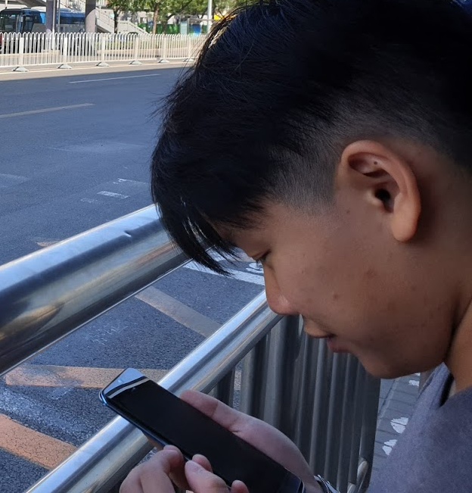
PROTOTYPE #1: RESULTS
Jazz,
transgender teen, skeptical of businesses and price-conscious
Yays:
Was able to identify a business’s values from the profiles
Felt like he would recognize Raven Dots if he encountered it in the wild
Nays:
Blurbs felt like advertisements -
he didn’t trust them
Surprises:
Didn’t want to go to any of them, but would pick H&M if he had to pick
Willing to pay more for reputable brands, but not to support unproven values
Learnings:
Wants more accountability/proof of businesses’ commitment to values, thinks an authentic video might be a way to go about that
Notes:
Smaller stores
“We would like you to pay more for the same or kind of the same product.”
“All of the environmental things are kind of a lie.”

Slide 17
PROTOTYPE #1: VALIDITY
Original Assumption:
Users prioritize impact over economy
Businesses have a story besides "better quality at better prices"
Key Learnings:
Users may not trust a story without some sort of proof
Users may view stories as advertisements
Notes:
Certain information will compel users to shop more than other (e.g. values driven vs price)

Slide 18
HMW #2
We met… Aniya, a Thai foodie who has been on the search for new restaurants since COVID caused some of her favorite places to shut down.
We were amazed to realize… some restaurants only advertise in a certain language and remain unknown to potential customers who don’t search in that language.
It would be game-changing to… help people overcome the language barrier and discover more authentic small restaurants.
How might we...
help customers and businesses communicate without needing language?
Our solution pick:
a virtual storefront with floating AR charts of image-driven products and deals a customer can view before entering a store

Slide 19
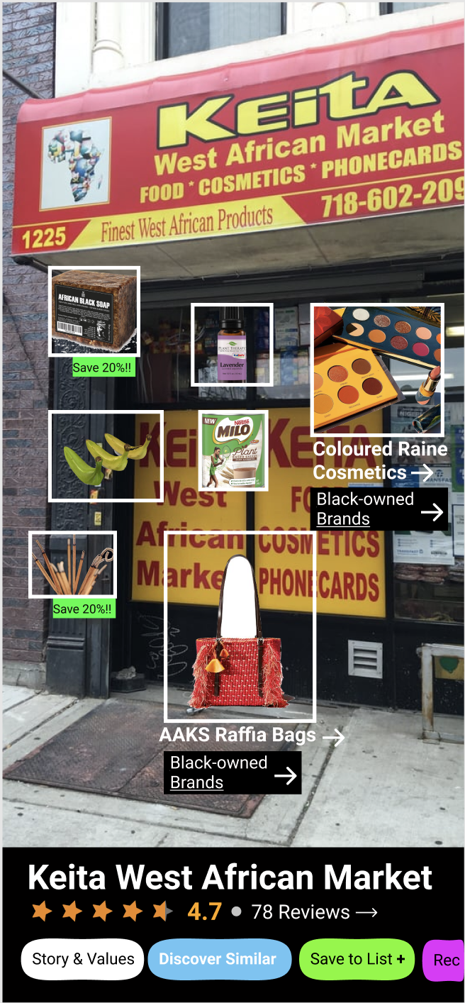
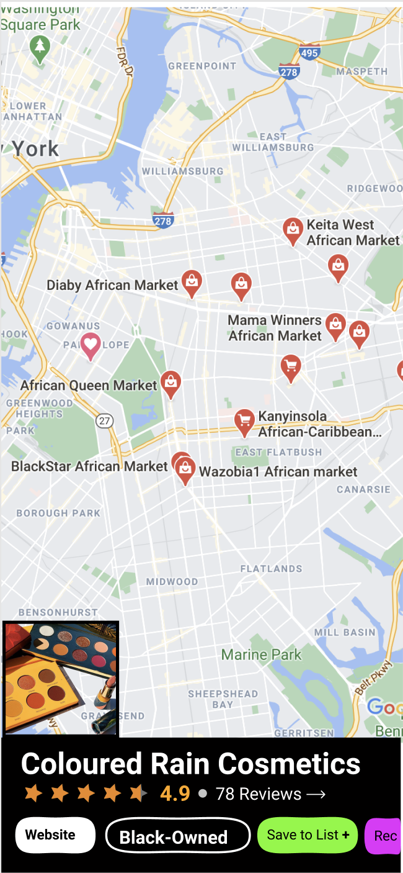

PROTOTYPE #2:
VIRTUAL STOREFRONT
Our solution pick:
A virtual storefront with floating AR charts of image-driven products and deals a customer can view before entering a store
We tested the assumption that:
With better information about what's inside, people will be more confident and going into a store, and more likely to seek out their chosen products at stores like it

Slide 20
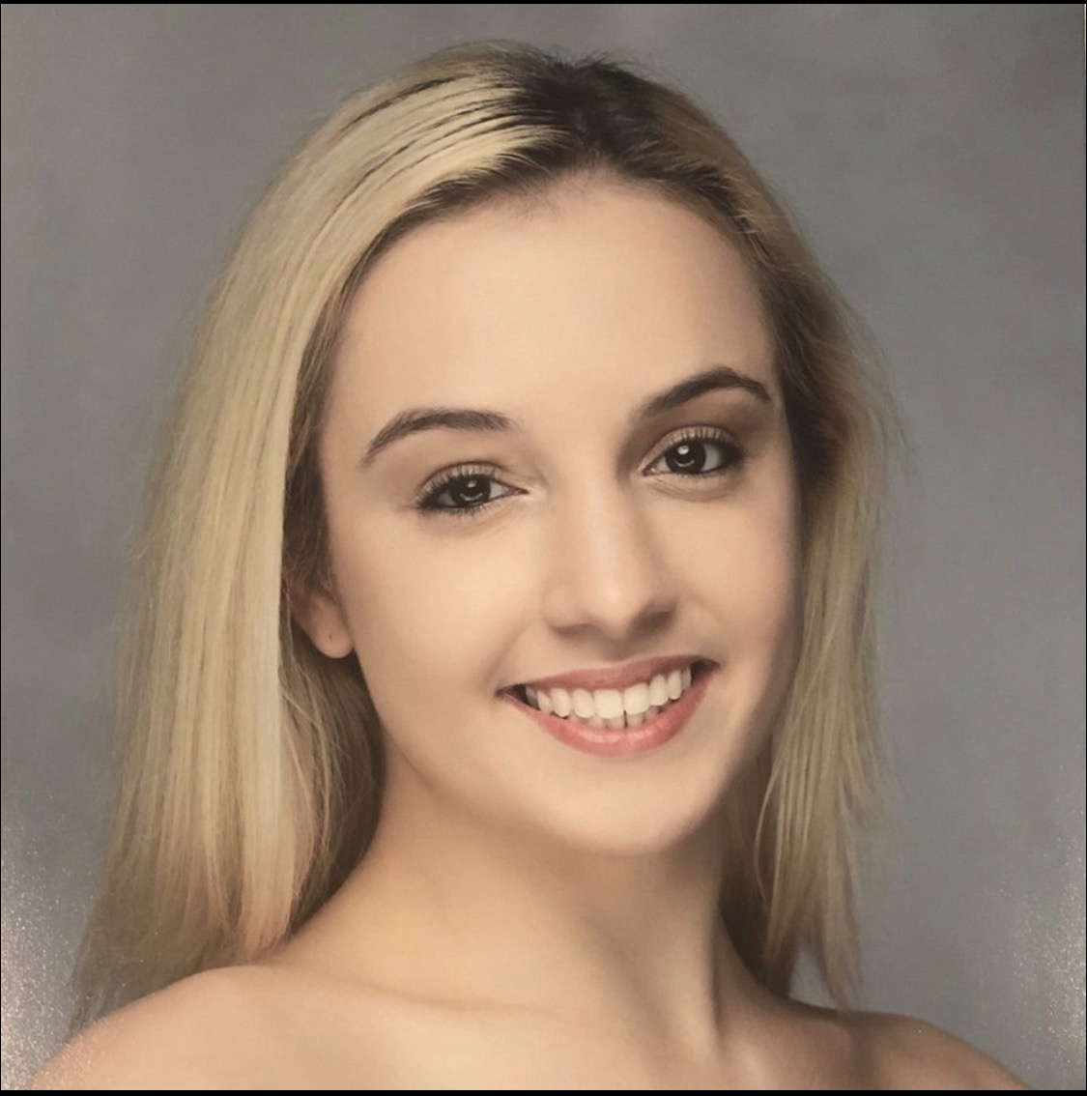
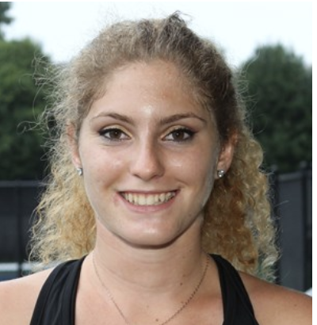
PROTOTYPE #2: RESULTS
Anastasia & Michelle,
love exploring but want more structure & personalization, seek to understand business values
Yays:
Grouping makes it easy to find your preferred brands and storefronts, no other tool does this as effectively
Good options for different use cases/ users
Helps efficiency & ease of shopping
Nays:
Virtual storefront could get overwhelming before even entering store
For this to be more efficient, the options must be super filtered and more browsable
Surprises:
The extra info can cause overload
Users would rather see personalized info first, then browse a full product list
Learnings:
“Combine with translation for readability”
Focus on making shopping “more comfortable/efficient, esp. in new places”
filter the options heavily for ease of use

Slide 21
PROTOTYPE #2: VALIDITY
Original Assumption:
With better information about what's inside, people will be more confident and going into a store, and more likely to seek out their chosen products at stores like it
Key Learnings:
More isn’t always better - filter & tailor a user’s options to prevent overwhelming
Most useful when paired with social networking & personalized recs (prioritize those features)
Notes:
Certain information will compel users to shop more than other (e.g. values driven vs price)

Slide 22
HMW #3
We met… Nathaniel, a college student who prioritizes having a larger selection and maximizing value when shopping.
We were amazed to realize… he defaults to staple retail brands (i.e. Walmart, Amazon) due to perception of consistent convenience and value.
It would be game-changing to… have better information around the availability and prices of items at more stores to get better options.
How might we...
recreate the sense of "familiarity" which draws consumers to chain businesses?
Our solution pick:
have local businesses across the country with similar values form “guilds” to signify their value alignment

Slide 23
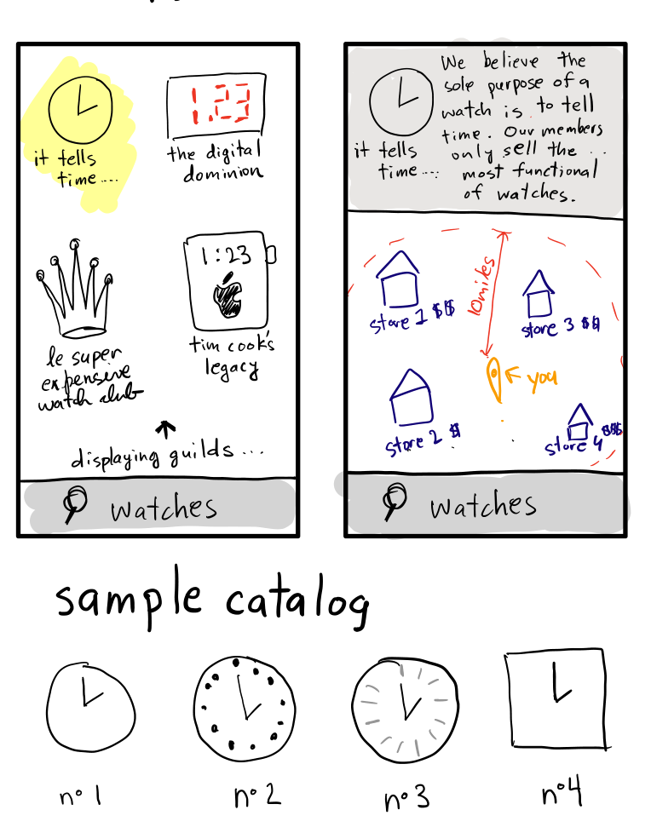
PROTOTYPE #3: GUILDS
Our solution pick:
Have local businesses across the country with similar values form “guilds” to signify their value alignment
We tested the assumption that:
The social credit / trust of a business can be transferred through a formal association.
Notes:
Possibly dfferentiated products but all with standards of quality
Search within a certain radius

Slide 24
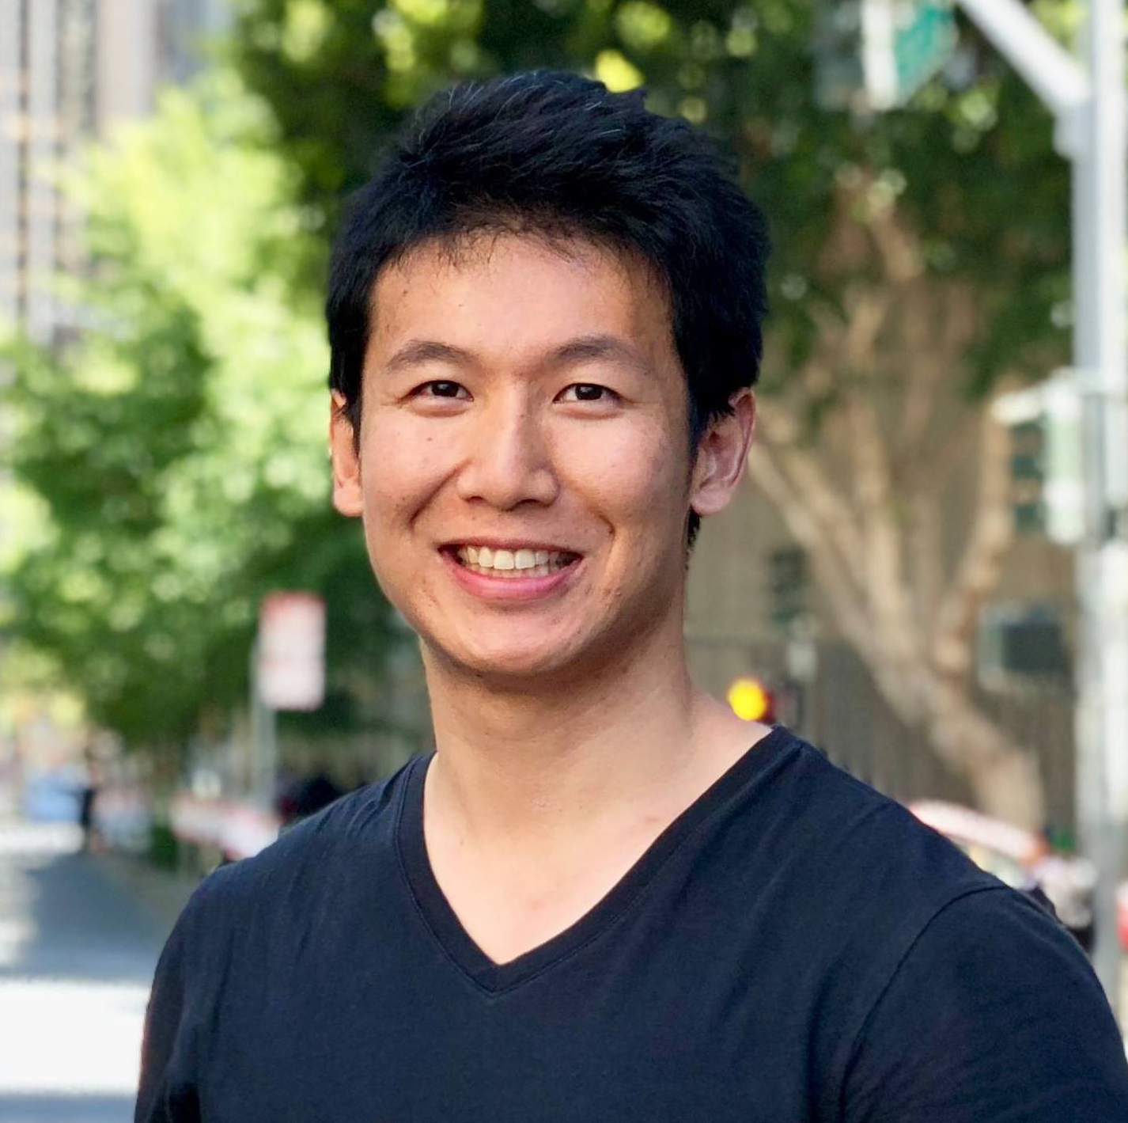
PROTOTYPE #3: RESULTS
Jerry,
loves traveling to new places via lo-fi modes of transportation
Yays:
Liked how it grouped stores with similar offerings together
Nays:
Thought map was confusing, still not sure where to go to find certain product
Guild qualities didn’t help him because he already had an idea what he wanted to buy
Surprises:
More focused on verifying the functionality, price, and quality of an item than the store selling it
Learnings:
“The map would be more useful if it showed more than the price range”
Felt like guilds would be more useful as a filtering option
Notes:
The map would be more useful if it showed more than the price range

Slide 25
PROTOTYPE #3: VALIDITY
Original Assumption:
A business's association with a larger group (guild) will establish trust with a consumer
Key Learnings:
People shop with an idea of what they need in mind
If the products don’t align with someone’s needs, association to other businesses doesn’t matter
Notes:
Certain information will compel users to shop more than other (e.g. values driven vs price)

Slide 26
Summary

Slide 27
Summary
Solution #1 - Trend of corporations pushing mission-driven initiatives has caused a distrust that businesses are authentically engaged with the community. Promoting these initiatives can feel like advertising.
Solution #2 - People feel flooded with options and would be more likely to explore if they were given more directed content from other people they trust.
Solution #3 - People generally shop with an idea of what they need in mind - if products don’t align with their needs, association to other businesses doesn’t matter.
We believe the best path forward is a combination of all three solutions, re-focusing on product discovery vs. business discovery.

Slide 28
QUESTIONS?

Slide 29
APPENDIX

Slide 30
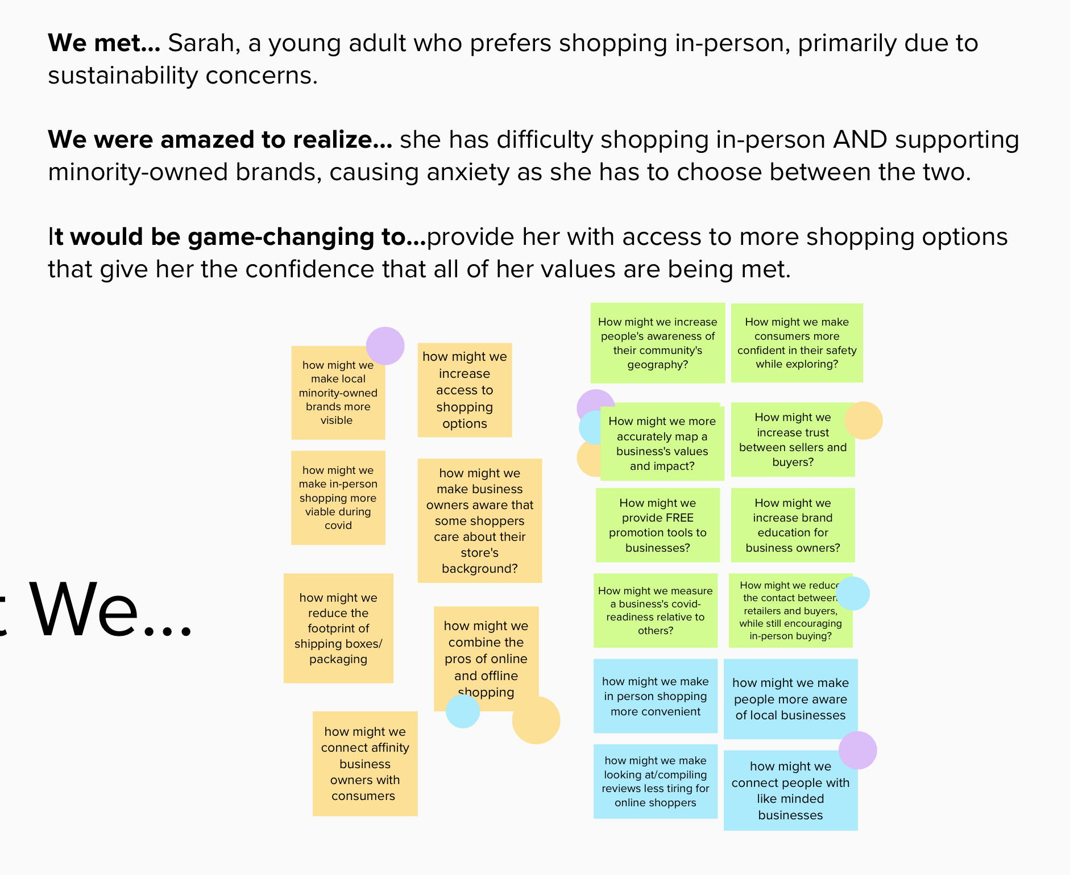
HMW BRAINSTORM - POV #1

Slide 31
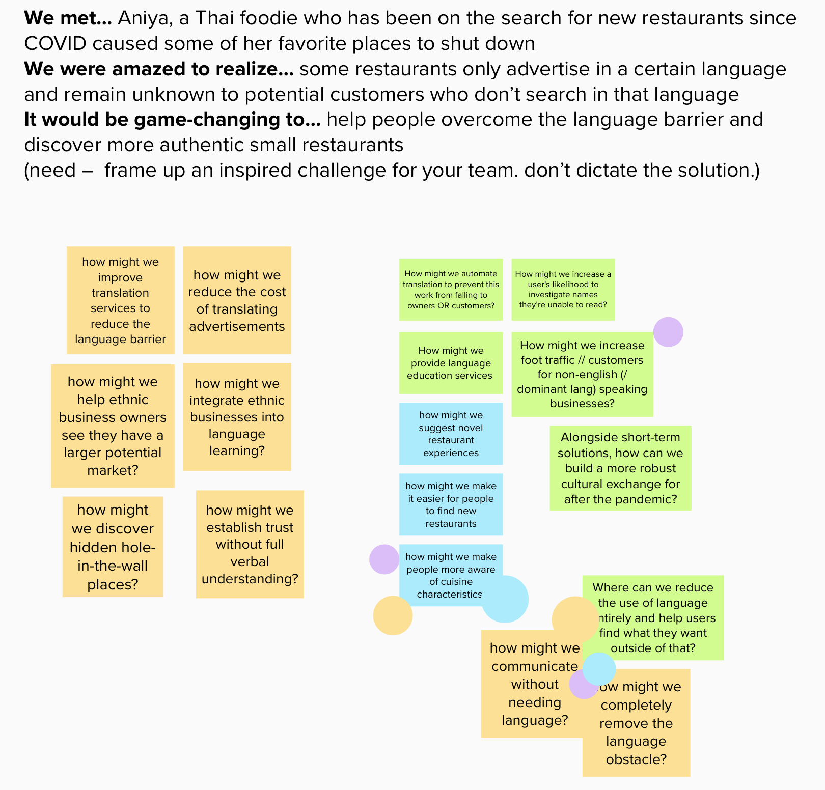
HMW BRAINSTORM - POV #2

Slide 32
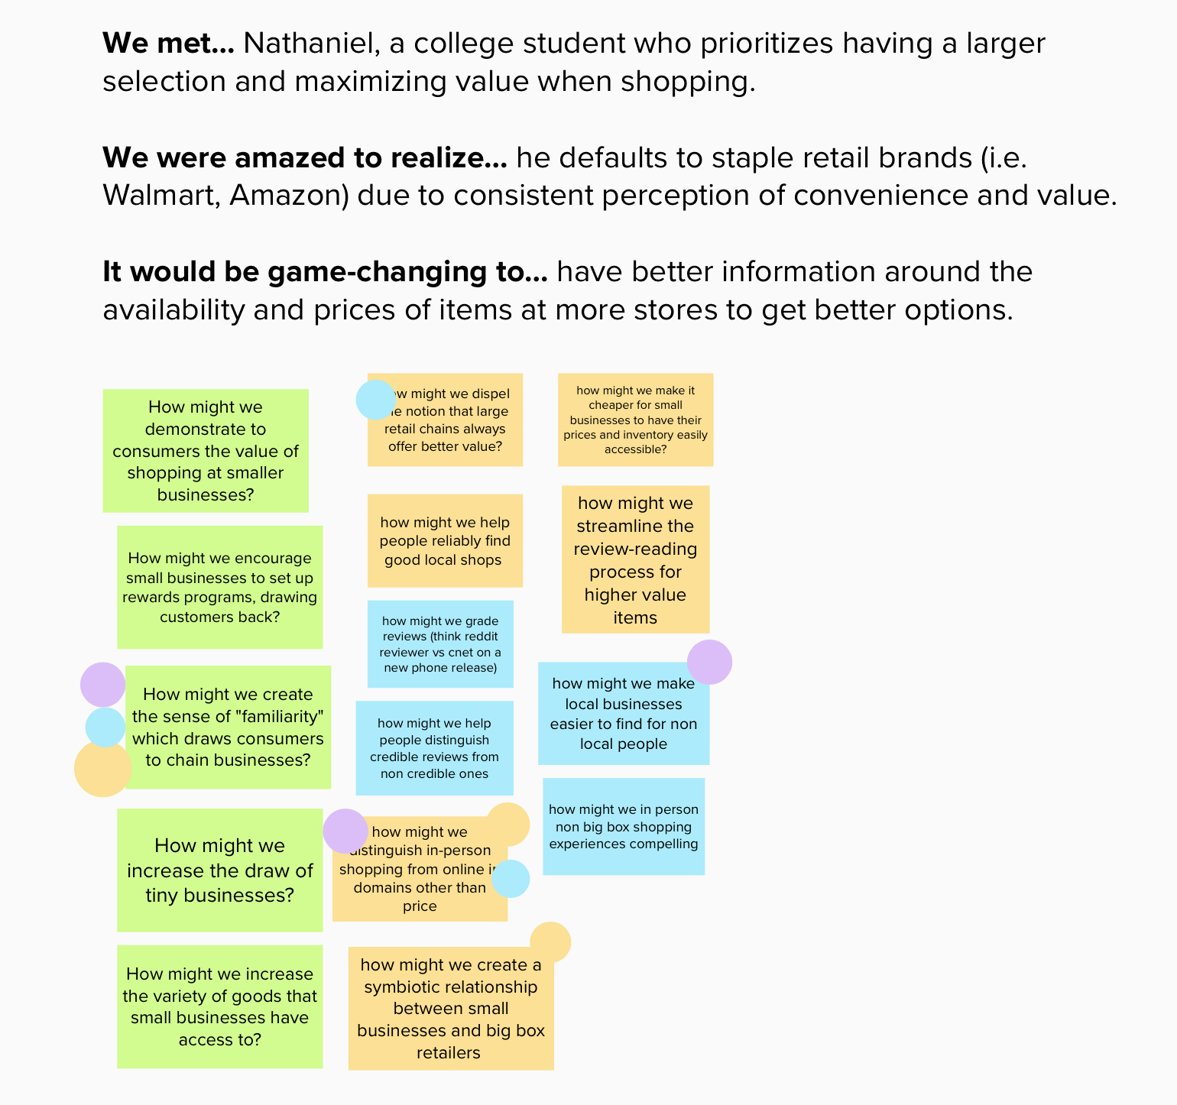
HMW BRAINSTORM - POV #3

Slide 33
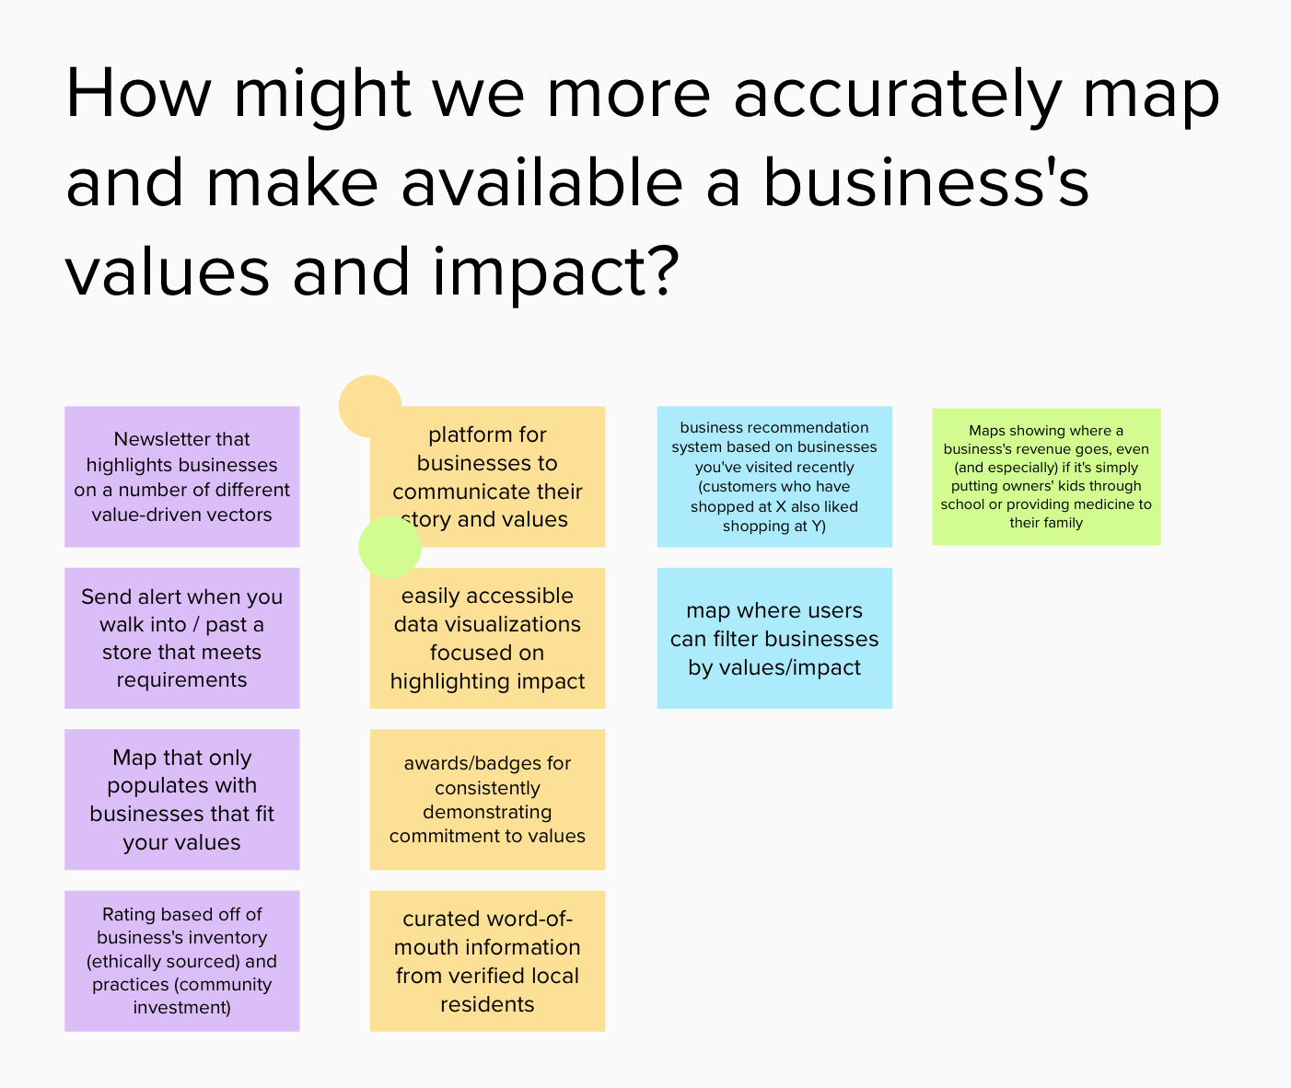
SOLUTION BRAINSTORM - HMW #1

Slide 34
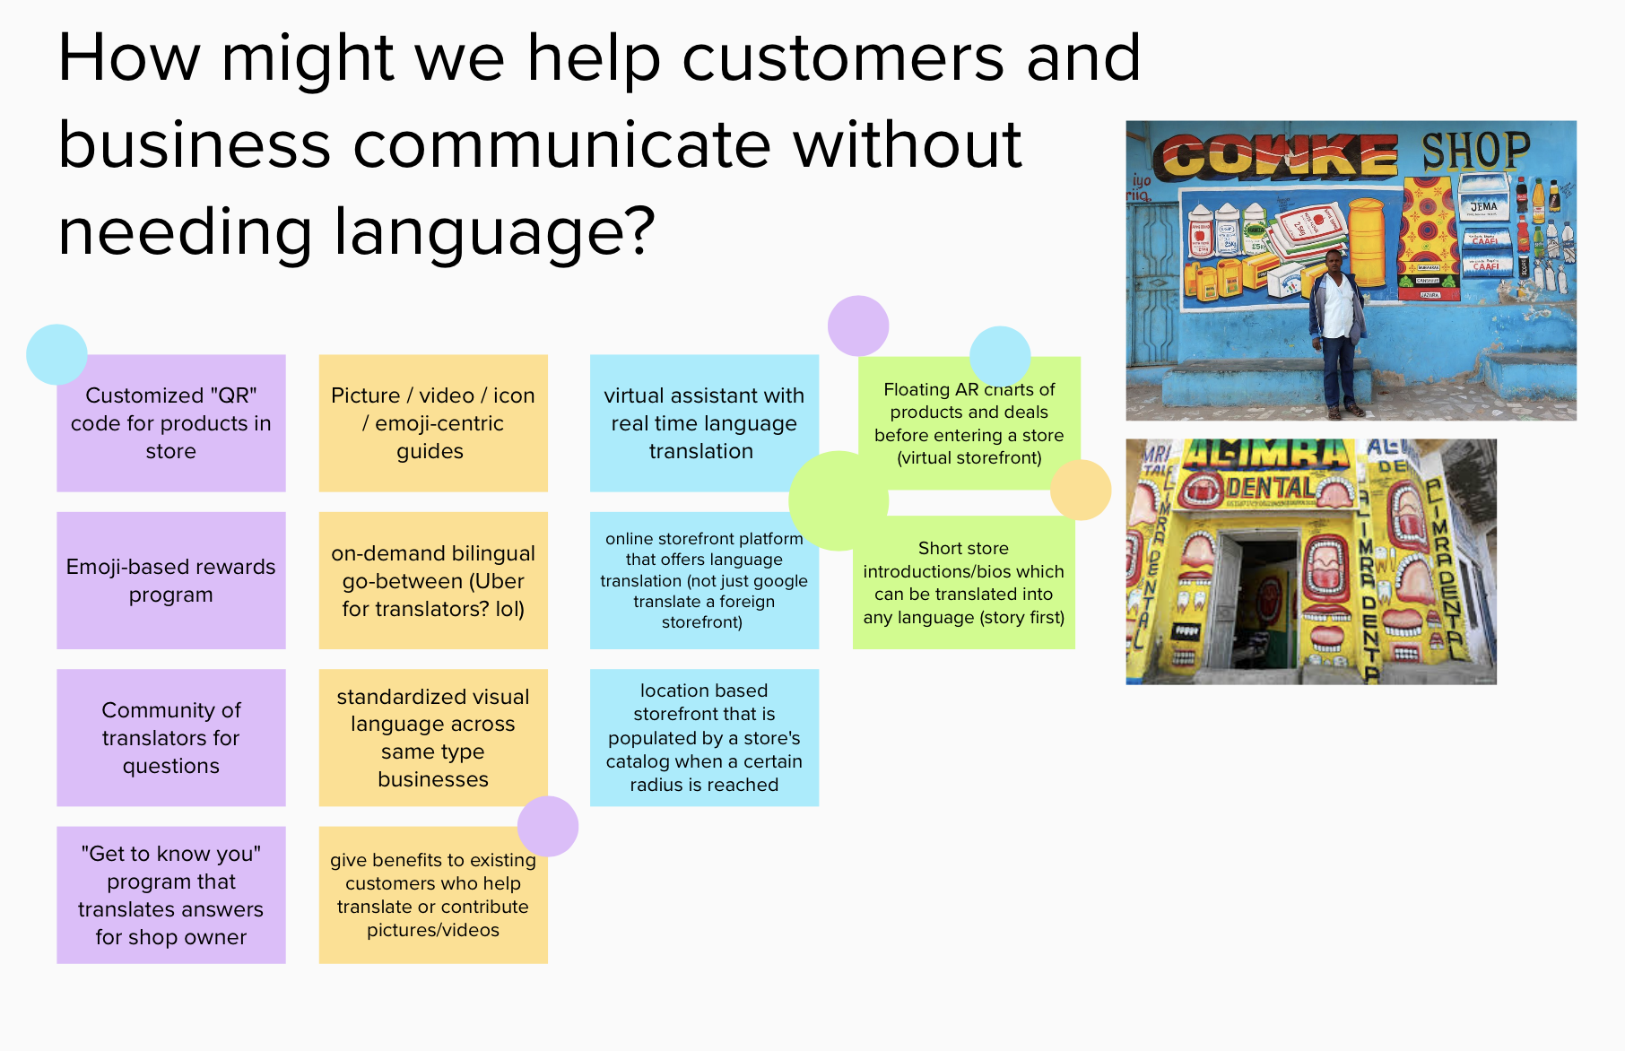
SOLUTION BRAINSTORM - HMW #2

Slide 35
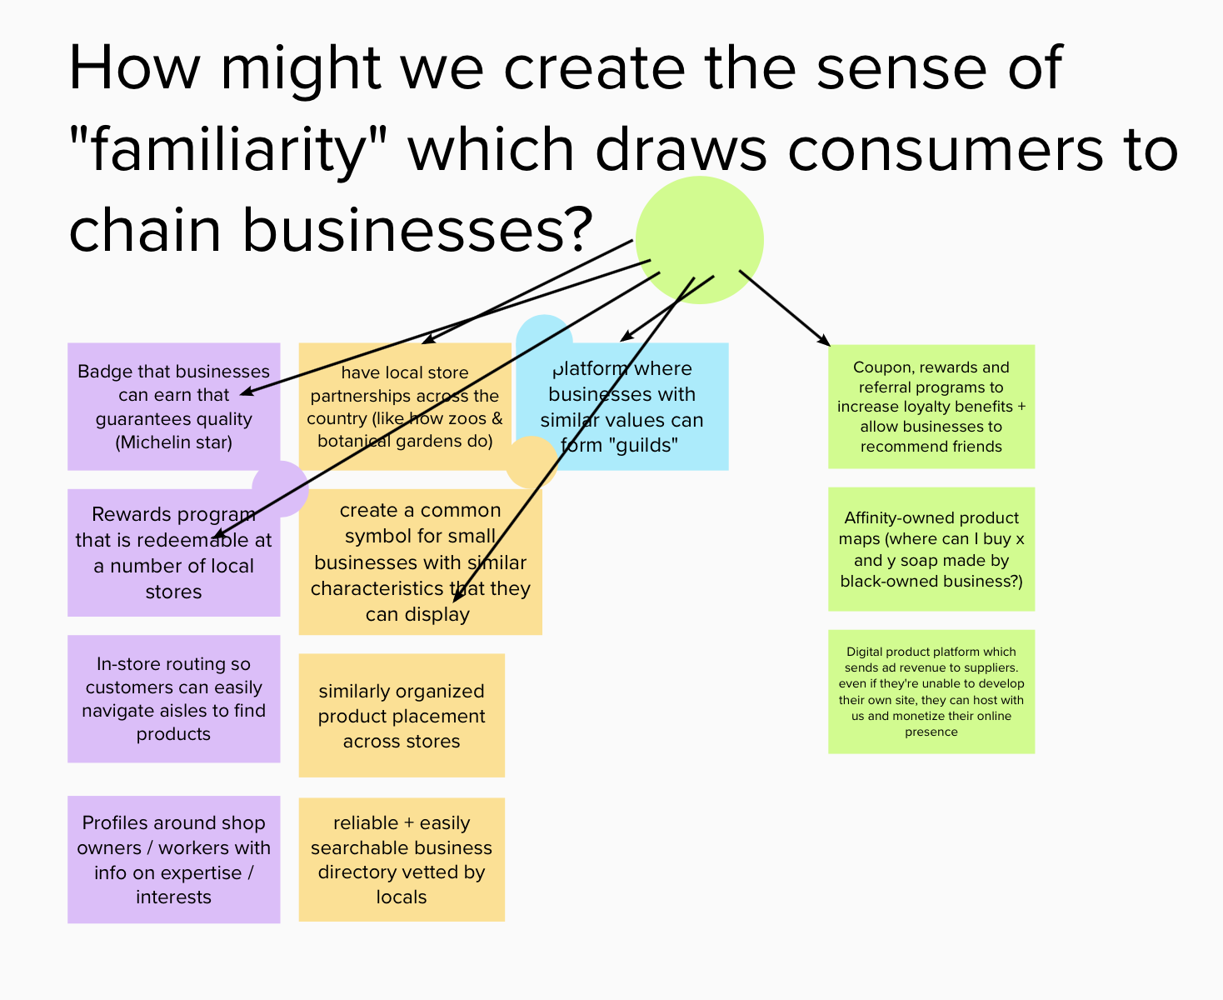
SOLUTION BRAINSTORM - HMW #3

Slide 36
EXPERIENCE PROTOTYPE SETUP
SOLUTION | Platform for businesses to communicate their story and values | Floating AR charts of image-driven products and deals before entering a store (virtual storefront) | Platform where businesses with similar values can form "guilds" with rewards redeemable at any location
ASSUMPTION | Users care about the story/history/values of a business | With better information about what's inside, people will be more confident going into a store | The social credit / trust of a business can be transferred through a formal association.
SCENES | Someone's home - bring it closer /more personable - show vetting possibilities "before even leaving comfort of your couch" | Outdoor of physical storefront the customer has never gone into before | In an unfamiliar location; either getting ready to go out or actively shopping.
PROPS | Screens showing different store options, some with different blurbs about the store's history, values, story, prices, some without + some big box stores | Mobile App to scan building; AR objects in front of store detailing deals, etc | Distinct, unique products + mobile app prototype showing associated businesses, possibly with available discounts / rewards
ROLES | Customer - someone interested in a product/browsing | Potential customer(s) walking past and unsure whats inside | Prospective customers in new area, hesitant about buying AT ALL until they know where they're going and why

